Slide 1
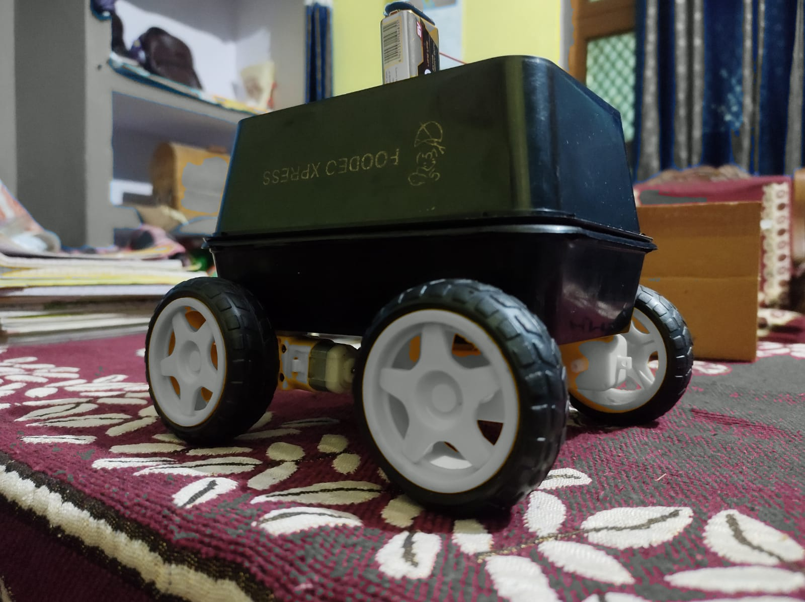
MANGALMAY INSTITUTE OF MANAGEMENT AND TECHNOLOGY
Speech Modulation car
Created by Vishal sharma

Slide 2
Introduction:-
This is an AI assistance controlled car, The AI assistance takes input directions from user (Operator of car) process it and send the input to the microprocessor (Arduino). Which reads the input and gives the desired output as the car moves forward , backward(reverse) ,to stop, moving left and right.

Slide 3
Inner Components of Model
Motor
Driver
Arduino UNO
Microproces-sor
Bluetooth
Module
Battery place

Slide 4
This AI car model consist of mainly five components :-
Arduino UNO microprocessor
Motor driver
Bluetooth module
TT Motors
Alkaline rechargeable battery (AAA batteries)
Jumper wires (M-M,M-F)

Slide 5
How it is operated
This car is operated with AI assistance , User gives the movement direction and sends the command as input command to the Arduino Uno microprocessor via Bluetooth module and Arduino chip processes it and decides which motor rotates and which is not.
The motor driver module is used to separates all the four motors because when the input command in the form of signals processed by the Arduino chip then it will goes to the motor driver and this will actually decides which motor rotates and which is not.

Slide 6

User
Input command
Command Signals
Command received by Bluetooth module
Output shown by movement
AI Assistance
Robo CAR
Interface portion

Slide 7
Our main purpose of creating this model is to gain knowledge and knows how to deal with microprocessor and input signals and expertise our coding skills by creating a python desktop assistance which helps user to makes the limited task easy and co-operative.
Key indexes :-
Enhance knowledge
Building logic and enhance coding skills
Learns how AI works
This project is created for self purpose only to enhance our knowledge by doing some creative tasks.

Slide 8
Thank you

